Slide 1

Working with Web Services
Lorna Mitchell
October 2009

Slide 2

Who am I?
Lorna Mitchell
PHP Developer/Consultant/Trainer at Ibuildings
Personal site at lornajane.net
European Rep for PHPWomen.org
PHPNW organiser
Twitter: @lornajane

Slide 3
Working with Web Services
Consuming existing services
Web services overview
Data types
Service types
Debugging
Using services from PHP

Slide 4
What are Web Services?
Machine-friendly applications
Formatted data instead of a web page

Slide 5
Why Do We Care?
Web services let us exchange data
  between systems
  within systems
Architecture looks like library or module boundary
Sharing information between systems cleanly
Notes:
can independently scale those modular elements

Slide 6
How do Web Services Work?
Client/Server
Sound familiar?
Request and response, just like a web application
Same theories apply

Slide 7
When Things Go Wrong
Errors will appear in response
We may not expect them
Apache logs
Debug output and logging
Verbose error-checking and logging from our app
Graceful failure

Slide 8

Data Formats

Slide 9
JSON
JavaScript Object Notation
Natively read/write in most languages
Very simple! (we like simple)
Limitations
  no data typing
  no distinction between object and array

Slide 10
Writing JSON from PHP
1 <?php
2
3 $menu['starter'] = array( "prawn cocktail",
4 "soup of the day");
5 $menu['main course'] = array( "roast chicken",
6 "fish 'n' chips",
7 "macaroni cheese");
8 $menu['pudding'] = array( "cheesecake",
9 "treacle sponge");
10
11 echo json_encode($menu);
{"starter":["prawn cocktail","soup of the day"],"main course":["roast chicken","fish 'n' chips","macaroni cheese"],"pudding":["cheesecake","treacle sponge"]}

Slide 11
Reading JSON from PHP
1 <?php
2
3 $json = '{"starter":["prawn cocktail","soup of the day"],"main course":["roast chicken","fish \'n\' chips","macaroni cheese"],"pudding":["cheesecake","treacle sponge"]}';
4
5 print_r(json_decode($json));

Slide 12
Reading JSON from PHP
stdClass Object
(
[starter] => Array
(
[0] => prawn cocktail
[1] => soup of the day
)
[main course] => Array
(
[0] => roast chicken
[1] => fish 'n' chips
[2] => macaroni cheese
)
[pudding] => Array
(
[0] => cheesecake
[1] => treacle sponge
)
)

Slide 13
XML
eXtensible Markup Language
Familiar
Can give more detail than JSON
Native read/write in most languages

Slide 14
Working with XML from PHP
Lots of options
SimpleXML
DOM

Slide 15
SimpleXML Example
1 <?php
2
3 $xml = <<< XML
4 <?xml version="1.0" ?>
5 <menus>
6 <menu>Lunch</menu>
7 <menu>Dinner</menu>
8 <menu>Dessert</menu>
9 <menu>Drinks</menu>
10 </menus>
11 XML;
12
13 $simplexml = new SimpleXMLElement($xml);
14 var_dump($simplexml);

Slide 16
SimpleXML Example
object(SimpleXMLElement)#1 (1) {
["menu"]=>
array(5) {
[0]=>
string(5) "Lunch"
[1]=>
string(6) "Dinner"
[2]=>
string(7) "Dessert"
[3]=>
string(6) "Drinks"
}
}

Slide 17
SimpleXML Example
1 <?php
2
3 $simplexml = simplexml_load_string('<?xml version="1.0" ?><menus/>');
4 $simplexml->addChild('menu','Lunch');
5 $simplexml->addChild('menu','Dinner');
6 $simplexml->addChild('menu','Drinks');
7 $simplexml->addChild('menu','Dessert');
8
9 echo $simplexml->asXML();

Slide 18
SimpleXML Example
<?xml version="1.0"?>
<menus>
<menu>Lunch</menu>
<menu>Dinner</menu>
<menu>Dessert</menu>
<menu>Drinks</menu>
</menus>

Slide 19
Serialised PHP
Native to PHP
Useful for values in database
Can also use to move data between PHP applications

Slide 20
Serialising Data in PHP
1 <?php
2
3 $menu['starter'] = array( "prawn cocktail",
4 "soup of the day");
5 $menu['main course'] = array( "roast chicken",
6 "fish 'n' chips",
7 "macaroni cheese");
8 $menu['pudding'] = array( "cheesecake",
9 "treacle sponge");
10
11 echo serialize($menu);
a:3:{s:7:"starter";a:2:{i:0;s:14:"prawn cocktail";i:1;s:15:"soup of the day";}s:11:"main course";a:3:{i:0;s:13:"roast chicken";i:1;s:14:"fish'n' chips";i:2;s:15:"macaroni cheese";}s:7:"pudding";a:2:{i:0;s:10:"cheesecake";i:1;s:14:"treacle sponge";}}

Slide 21
Unserialising Data in PHP
1 <?php
2
3 $serialised = 'a:3:{s:7:"starter";a:2:{i:0;s:14:"prawn cocktail";i:1;s:15:"soup of the day";}s:11:"main course";a:3:{i:0;s:13:"roast chicken";i:1;s:14:"fish \'n\' chips";i:2;s:15:"macaroni cheese";}s:7:"pudding";a:2:{i:0;s:10:"cheesecake";i:1;s:14:"treacle sponge";}}';
4
5 var_dump(unserialize($serialised));

Slide 22
Unserialising Data in PHP
array(3) {
["starter"]=>
array(2) {
[0]=>
string(14) "prawn cocktail"
[1]=>
string(15) "soup of the day"
}
["main course"]=>
array(3) {
[0]=>
string(13) "roast chicken"
[1]=>
string(14) "fish 'n' chips"
[2]=>
string(15) "macaroni cheese"
}
["pudding"]=>
array(2) {
[0]=>
string(10) "cheesecake"
[1]=>
string(14) "treacle sponge"
}
}

Slide 23
Service Types

Slide 24
Service Types
SOAP
*-RPC
  XML-RPC
  JSON-RPC
REST

Slide 25
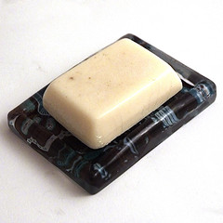
SOAP
Just "soap"
Defined XML format
Also includes definition for error format
Wrappers available for most languages
Optionally uses a WSDL to describe the service
  Web Service Description Language
http://www.flickr.com/photos/kerryw/3824338526

Slide 26
Example WSDL
<?xml version ='1.0' encoding ='UTF-8' ?>
<definitions name='MyClass' targetNamespace='urn:MyClassInventory' xmlns:tns='urn:MyClassInventory' xmlns:soap='http://schemas.xmlsoap.org/wsdl/soap/' xmlns:xsd='http://www.w3.org/2001/XMLSchema' xmlns:soapenc='http://schemas.xmlsoap.org/soap/encoding/' xmlns:wsdl='http://schemas.xmlsoap.org/wsdl/' xmlns='http://schemas.xmlsoap.org/wsdl/'>
<message name='getAccountStatusRequest'>
<part name='accountID' type='xsd:string'/>
</message>
<message name='getAccountStatusResponse'>
<part name='accountID' type='xsd:string'/>
<part name='counter' type='xsd:float' />
</message>
<portType name='MyClassPortType'>
<operation name='getAccountStatus'>
<input message='tns:getAccountStatusRequest'/>
<output message='tns:getAccountStatusResponse'/>
</operation>
</portType>
<binding name='MyClassBinding' type='tns:MyClassPortType'>
<soap:binding style='rpc'
transport='http://schemas.xmlsoap.org/soap/http'/>
<operation name='getAccountStatus'>
<soap:operation soapAction='urn:xmethods-delayed-quotes#getAccountStatus'/>
<input>
<soap:body use='encoded' namespace='urn:xmethods-delayed-quotes' encodingStyle='http://schemas.xmlsoap.org/soap/encoding/'/>
</input>
<output>
<soap:body use='encoded' namespace='urn:xmethods-delayed-quotes'
encodingStyle='http://schemas.xmlsoap.org/soap/encoding/'/>
</output>
</operation>
</binding>
<service name='MyClassService'>
<port name='MyClassPort' binding='tns:MyClassBinding'>
<soap:address location='http://rivendell.local:10002/MyClassServiceServer.php'/>
</port>
</service>
</definitions>

Slide 27
WSDL tips
Read from end to beginning
  Service location and name
  Method names and bindings
  Details of request/response messages
  Variable names and data types used for each request/response
  Data type definitions
  Namespace information

Slide 28
PHP SOAP Client Example
1 <?php
2
3 ini_set('soap.wsdl_cache_enabled','0');
4
5 require_once('lib/Snapshot.php');
6
7 $wsdl = "Service.wsdl";
8 $client = new SoapClient($wsdl, $params);
9
10 $output = $client->requestShot(
11 'http://www.php.net','', 300, 400);

Slide 29
Troubleshooting SOAP
Check request
  $client->getLastRequest()
Check request headers
  $client->getLastRequestHeaders()
Check WSDL
Data types can be an issue between different client/server languages

Slide 30


HTTP Debugging Tools
cURL
  http://curl.haxx.se/
Wireshark
  http://www.wireshark.org/
Charles
  http://www.charlesproxy.com/

Slide 31
cURL
cURL is a command-line tool
Simple but powerful
Specify HTTP verb
Observe full request/response headers
Handle cookies

Slide 32
cURL Cheat Sheet
curl http://localhost
-v to show request/response
-I to show response headers
-X to specify HTTP method
-d to add a data field
-c to store cookies in a cookiejar
-b to use a cookiejar with request

Slide 33
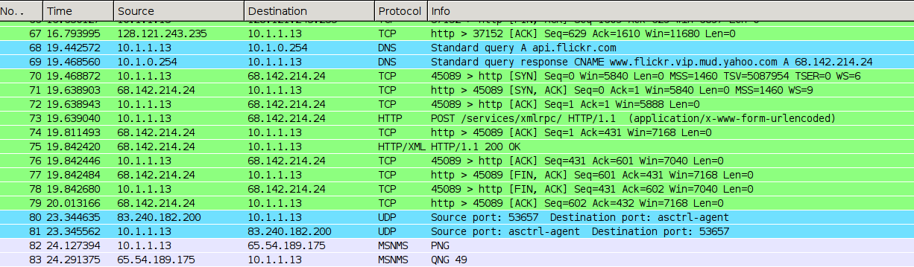
Wireshark Examples

Slide 34
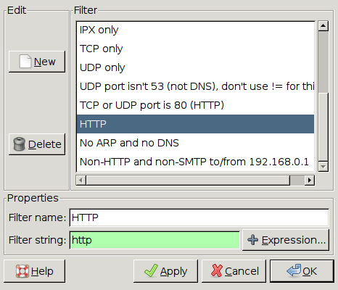
Wireshark Examples

Slide 35
Wireshark Examples

Slide 36
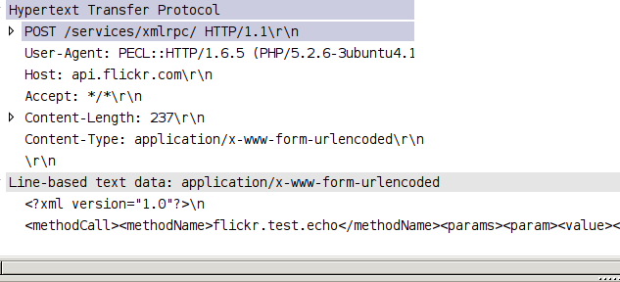
Wireshark Examples

Slide 37
RPC Services
Remote Procedure Call
Similar to library
Call function with arguments

Slide 38

Example RPC services
Using Flickr's XML-RPC
Test method: just echoes back to user
XML formatted data

Slide 39
Flickr Echo Example: XML
<?xml version="1.0"?>
<methodCall>
<methodName>flickr.test.echo</methodName>
<params>
<param>
<value>
<struct>
<member>
<name>api_key</name>
<value>....</value>
</member>
</struct>
</value>
</param>
</params>
</methodCall>

Slide 40
RPC from PHP: curl
1 <?php
2
3 // $xml is existing SimpleXMLElement Object
4 $url = 'http://api.flickr.com/services/xmlrpc/';
5 $ch = curl_init($url);
6
7 curl_setopt($ch, CURLOPT_POST, 1);
8 curl_setopt($ch, CURLOPT_POSTFIELDS, $xml->asXML());
9
10 $response = curl_exec($ch);
11 curl_close($ch);

Slide 41
RPC from PHP: pecl_http
1 <?php
2
3 $url = 'http://api.flickr.com/services/xmlrpc/';
4
5 // procedural method
6 $response = http_post_data($url, $xml->asXML());
7
8 // alternative method
9 $request = new HTTPRequest($url, HTTP_METH_POST);
10 $request->setRawPostData($xml->asXML());
11 $request->send();
12 $response = $request->getResponseBody();
13
14 var_dump($response);

Slide 42
Flickr Response
<?xml version="1.0" encoding="utf-8" ?>
<methodResponse>
<params>
<param>
<value>
<string>&lt;api_key&gt;54rt346&lt;/api_key&gt;
</string>
</value>
</param>
</params>
</methodResponse>

Slide 43
Wrapping RPC
RPC is a library-like interface
Can easily wrap existing libraries to call like this
Can wrap an interface to an RPC service to look like a library

Slide 44
Wrapping RPC Example
1 <?php
2
3 class Handler
4 {
5 function __call($method, $args) {
6 $ch = curl_init('http://localhost');
7 $data['method'] = $method;
8 foreach($args as $a) $data[$a] = $a;
9
10 curl_setopt($ch, CURLOPT_POST,1);
11 curl_setopt($ch, CURLOPT_POSTFIELDS, $data);
12 $response = curl_exec($ch); curl_close($ch);
13
14 var_dump($response);
15 }
16 }
17 $h = new Handler();
18 $h->dance('cat','dog','rabbit','penguin');
19

Slide 45
Troubleshooting RPC
Break down into smallest steps
Can you get a response from the service?
Can you log in?
Is there an error?
Try to debug the details of the request/response

Slide 46

REST
REpresentational State Transfer
Not a protocol
More like a philosophy
http://www.flickr.com/photos/katiew/191128057/

Slide 47
REST Overview
A series of concepts
Generally uses HTTP (HyperText Transfer Protocol)
URLs are resource locations
Verbs tell the service what to do
Status codes indicate what the outcome was
Notes:
15 mins

Slide 48
HTTP Status Codes
Code | Meaning
200 | OK
302 | Found
301 | Moved
401 | Not Authorised
403 | Forbidden
404 | Not Found
500 | Internal Server Error

Slide 49
REST CRUD
Action | HTTP Verb
Retrieve | GET
Create | POST
Update | PUT
Delete | DELETE

Slide 50
REST Examples
GET
  http://localhost/users
  http://localhost/users/harry
POST
  http://localhost/users
PUT
  http://localhost/users/harry
DELETE
  http://localhost/users/harry

Slide 51
REST from PHP: GET
1 <?php
2
3 $result = file_get_contents('http://localhost/users');
4 var_dump($result);

Slide 52
REST from PHP: GET
1 <?php
2
3 $ch = curl_init('http://localhost/users');
4
5 curl_exec($ch);
Health Warning!
  curl will echo output
  use CURLOPT_RETURNTRANSFER to capture it instead

Slide 53
REST from PHP: POST
1 <?php
2
3 $ch = curl_init('http://localhost/users');
4
5 $data = array ("name" => "Cho Chang",
6 "house" => "Ravenclaw");
7
8 curl_setopt($ch, CURLOPT_POST, 1);
9 curl_setopt($ch, CURLOPT_POSTFIELDS, $data);
10
11 curl_exec($ch);

Slide 54
REST from PHP: PUT
1 <?php
2
3 $ch = curl_init('http://localhost/users/cho');
4
5 $data = array ("name" => "Cho Chang",
6 "house" => "Ravenclaw"
7 "age" => 15);
8
9 curl_setopt($handle, CURLOPT_CUSTOMREQUEST, 'PUT');
10 curl_setopt($ch, CURLOPT_POSTFIELDS, $data);
11
12 curl_exec($ch);
13
Notes:
parse_str(file_get_contents("php://input"),$post_vars);

Slide 55
REST from PHP: DELETE
1 <?php
2
3 $ch = curl_init('http://localhost/users/ginny');
4
5 curl_setopt($ch, CURLOPT_CUSTOMREQUEST, 'DELETE');
6
7 curl_exec($ch);

Slide 56
Troubleshooting REST
Does resource exist?
Is there a status code?
What does the response body look like?
Intercept web traffic
Use command line curl

Slide 57
Working with Web Services

Slide 58
Working with Web Services
Consuming existing services
Web services overview
Data types
Service types
Debugging
Using services from PHP

Slide 59
Top tips
If your app can't talk to the service, can you get closer to the service?
If you control both server and client, add debug output
Use proxies to record what happens
Start with the lowest common denominator and work up

